Slide 1
Atlas Football Club Dataset Analysis using JASP
Submitted by
Group: 4
Aastha Joshi : 20020845001
Agnihotri Ghosh : 20020845003
Mohit Tiwari : 20020845017
Taksande Sandeep ravindra : 20020845030

Slide 2
Data Cleaning & Data Pre-processing
The dataset was manually cleaned by deleting the rows containing the “in” responses.
The float numbers were also deleted manually by using filtering method.
Then, in JASP, the category of the variables were changed to Scale for analysis.

Slide 3
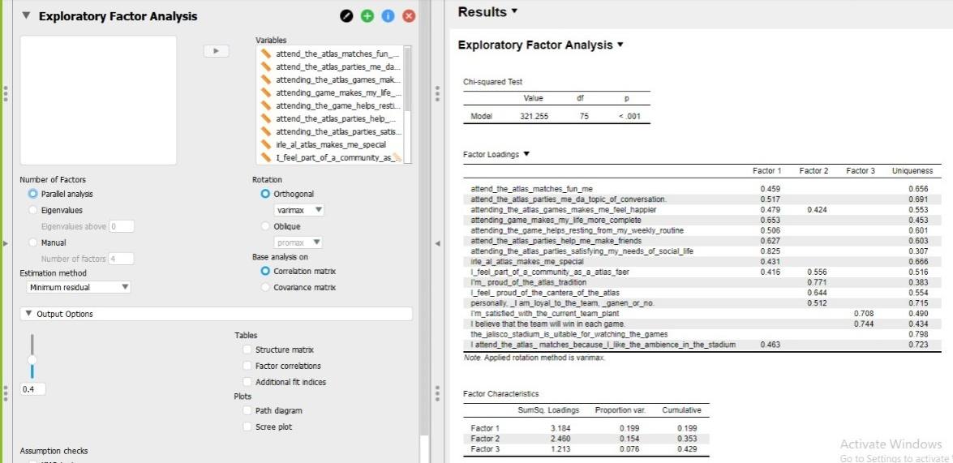
Factor 1: Sentiments towards Atlas Club
Factor 2: Loyalty & Pride
Factor 3: Satisfaction & Belief

Slide 4
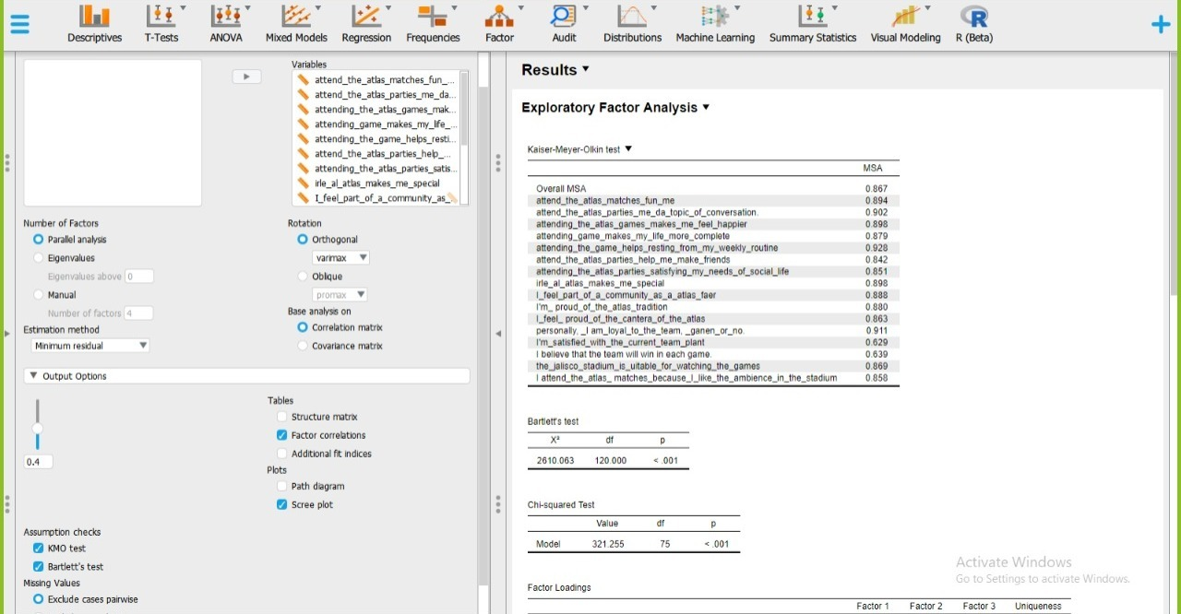
From Kaiser-Meyer-Olkin (KMO) measure of sampling adequacy (MSA), it can be seen that the values are between 0.5 and 1.0, indicating high appropriateness of factor analysis. AN overall MSA value (0.867) shows high appropriateness that each variable in a set is predicted without error by the other variable.
From Bartlett's test of sphericity, it can be seen that the P-value is <0.01, i.e., the null hypothesis can be rejected and the variables are correlated in the population.

Slide 5
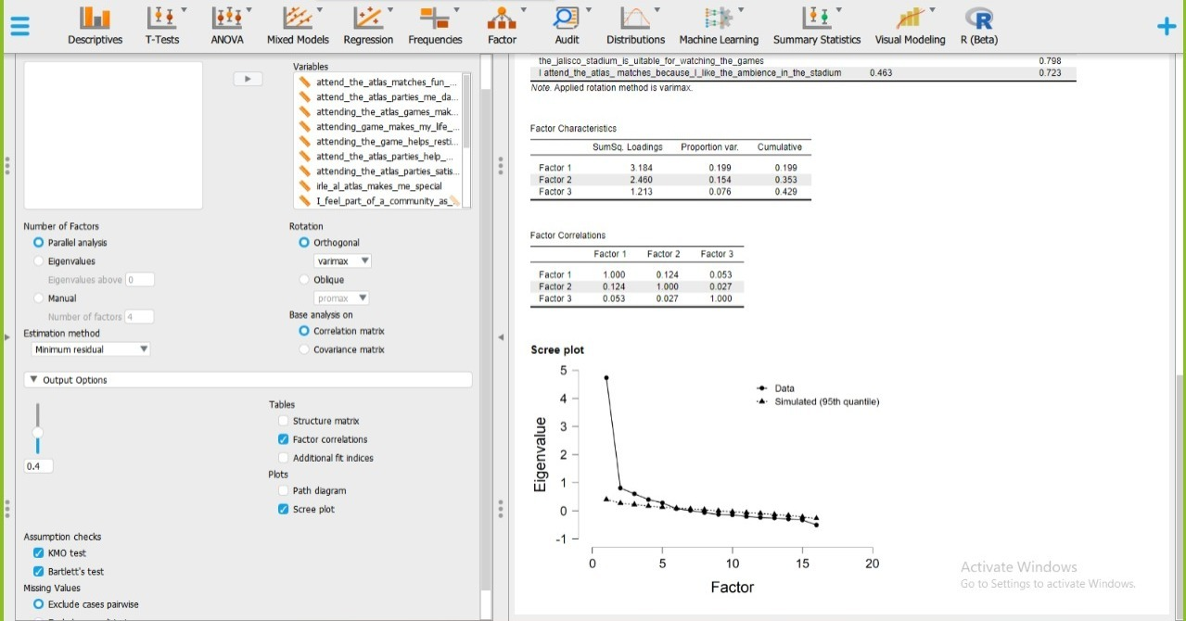
Scree Plot: The scree plot is used to determine the number of factors to retain in an exploratory factor analysis (FA) or principal components to keep in a principal component analysis (PCA).
The plot here shows that ‘5’ relevant components or factors to be retained in an Exploratory Factor Analysis to keep in a Principle Component Analysis

Slide 6
THANK YOU!

